Slide 1
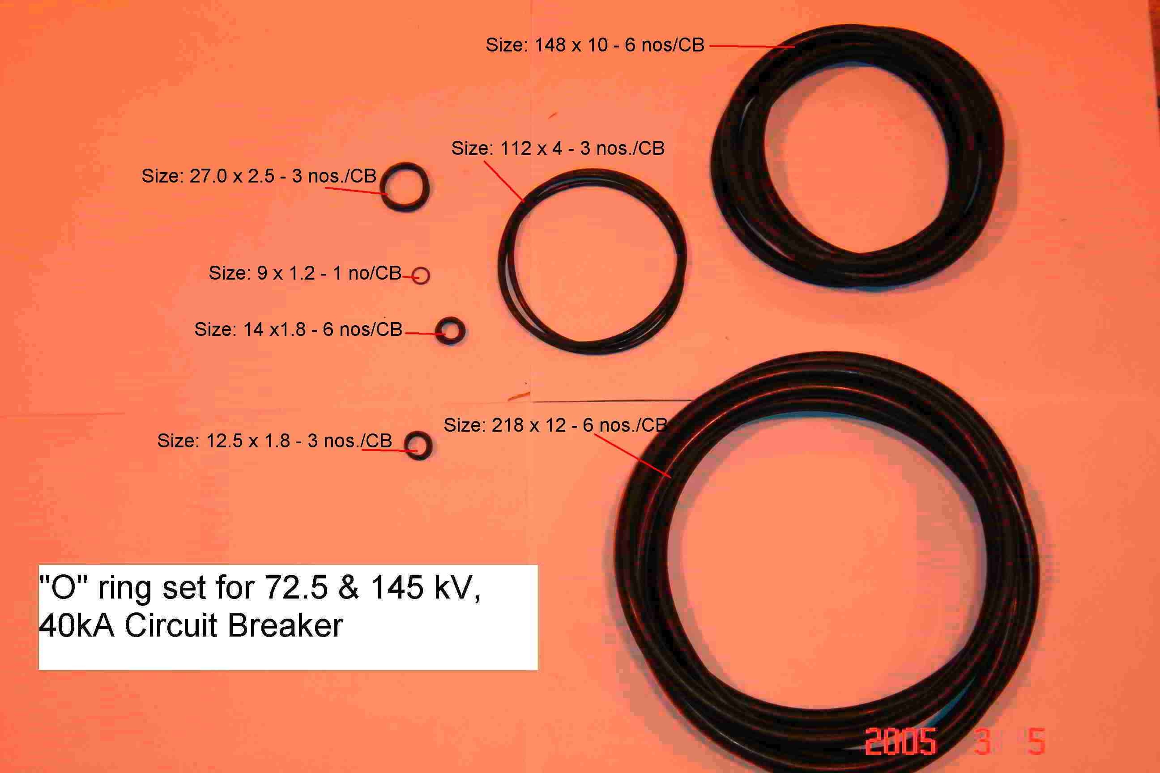
SIEMENS
HVCB SPARES
“O” rings set for complete 72.5KV, 145KV,40KA CB
S4799245301

